Slide 1
Hyperspectral Vision: A Lightweight 2D-to-3D
Reconstruction and Skinning Pipeline
(Research Track)
Aditya Aggarwal (2022028)
Aditya Upadhyay (2022040)
Arpan Verma (2022105)
Chandan Shah (2022140)

Slide 2
Introduction
Problem Statement
3D Mesh Reconstruction: Develop a method to reconstruct accurate 3D meshes from 2D images by learning template-based deformations.
Skinning Weight Estimation: Estimate per-vertex skinning weights and transformations to replicate observed deformations.
Skeleton Generation: Generate plausible bone structures to support realistic animation and further motion analysis
Motivation and Relevance
Applications: The proposed approach has practical applications in animation compression, real-time character control, and creating lifelike AR/VR avatars.
Challenges: Addressing challenges such as limited 2D views, unsupervised learning, and the need for high-fidelity 3D reconstructions.
Importance: By minimizing the need for manual rigging, this method facilitates accessible and efficient 3D modeling from commonly available 2D data.

Slide 3
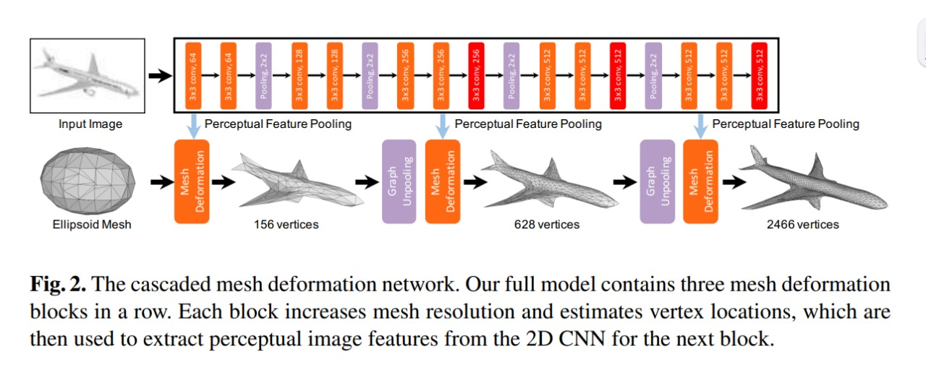
Baseline
3D Reconstruction
Pixel2Mesh: Uses graph convolutional networks to progressively deform an initial ellipsoid into a 3D mesh. We adopt this as our primary baseline (Implemented) for 2D-to-3D reconstruction.
Learning Free-Form Deformations for 3D Object Reconstruction: Employs a MobileNet backbone with free-form deformation (FFD) to deform a template mesh from a single image, influencing our design choices.
Inverse Skinning Methods
Hyperspectral Inverse Skinning: reformulates as a minimum-volume simplex problem to extract skinning weights and transformations from a set of deformed meshes.

Slide 4
Potential Research Gaps
Unified Pipeline: Lack of an integrated, minimally supervised approach that combines 2D-to-3D reconstruction with inverse skinning.
Better Information: Preserving face connectivity on 1-ring neighbour’s graph and preventing feature bleeding.
Balanced Performance: Need for improved reconstruction fidelity while ensuring computational efficiency, particularly for mobile and embedded platforms.
Bone Generation Mechanism plugged after LBS to have a defined bone structure.

Slide 5
Data Analysis and Eval Metrics
Data Analysis
Synthetic Data: Rendered images generated from ShapeNet objects.
Ground Truth Meshes: Sourced from previous works like Pixel2Mesh and hyperspectral inverse skinning datasets.
Evaluation Metrics
2D-to-3D Reconstruction:
Chamfer Distance (CD): Measures the average distance between predicted and ground-truth point clouds.
F-Score: Evaluates surface reconstruction accuracy based on the overlap between predicted and actual meshes.
Pose Reconstruction Error: Computes the distance between predicted and ground-truth vertex positions to assess pose accuracy.
Bone Structure Consistency: Conducts a qualitative comparison of the generated bone structures to evaluate realism and alignment with ground truth.

Slide 6
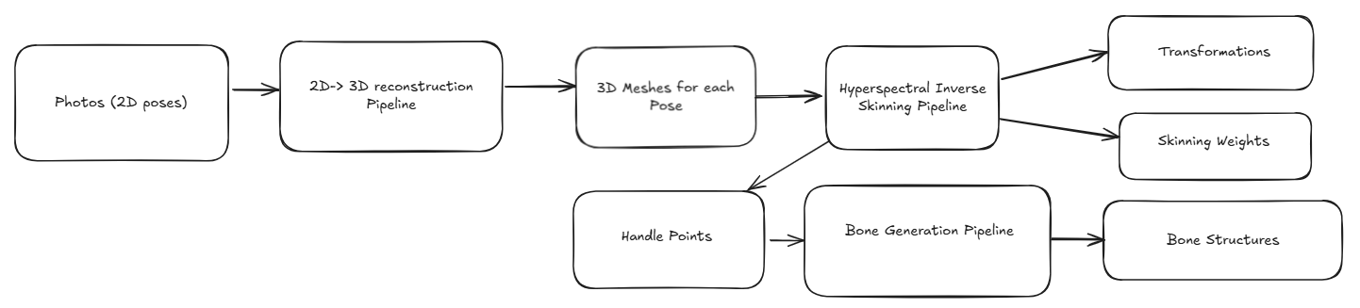
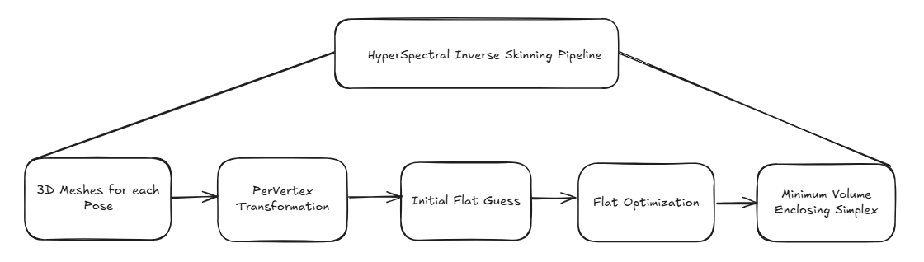
Pipeline
Key Point
Connecting the 3-dimensional Reconstruction module with the Hyperspectral Inverse Skinning module introduces the challenge of error propagation, where inaccuracies in 3D reconstruction can affect skinning results.

Slide 7
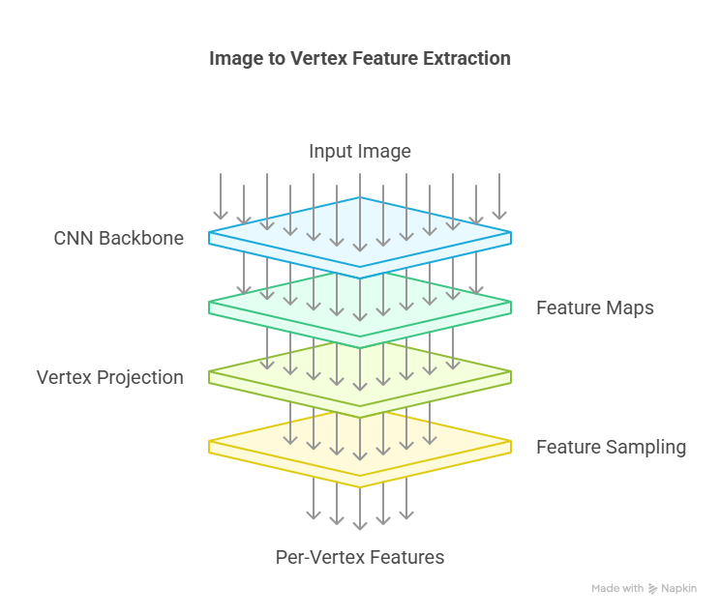
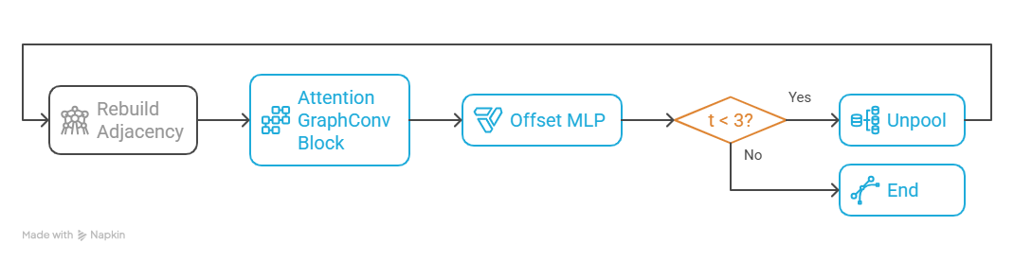
Proposed 2D-to-3D Architecture
Refinement Stage Process
←Image to Vertex Feature Extraction

Slide 8
Rationale and Benefits
Mesh topology awareness: Unlike voxel or point–cloud decoders, a GCN operates directly on the mesh’s 1-ring neighbourhood graph, preserving face connectivity by construction. This lets the network predict vertex offsets that respect local manifold structure, eliminating post-processing to recover a watertight surface.
Dynamic neighbourhood recomputation: Rebuilding the k-NN graph after each refinement stage adapts information flow to the current geometry, preventing feature “bleeding” when vertices slide across curved surfaces.
Hierarchical refinement: Progressive unpooling (coarse → fine) mirrors classical subdivision modelling: coarse layers capture global silhouette while later layers refine high-frequency details.

Slide 9
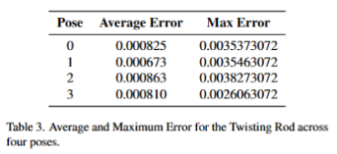
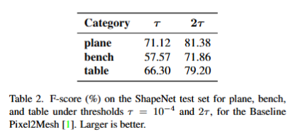
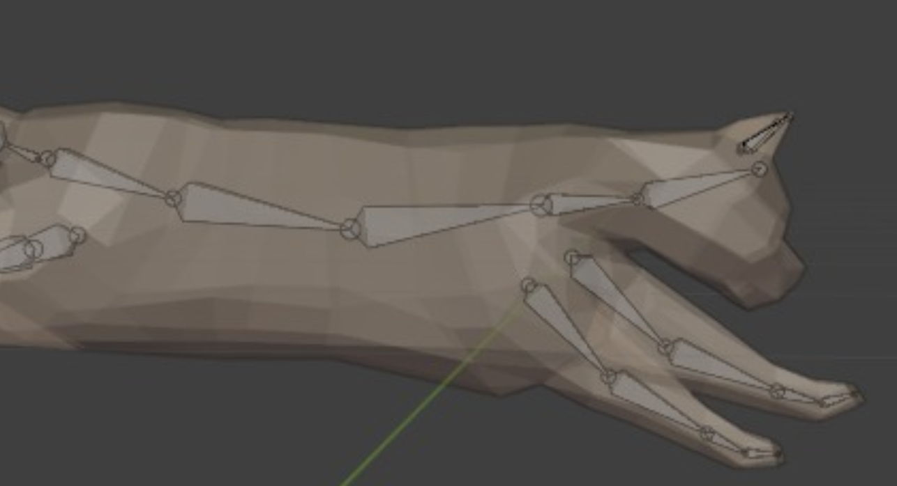
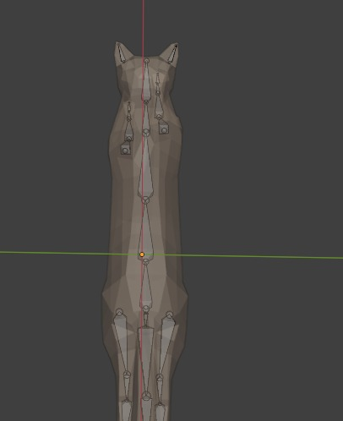
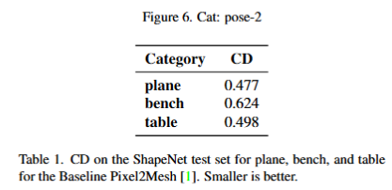
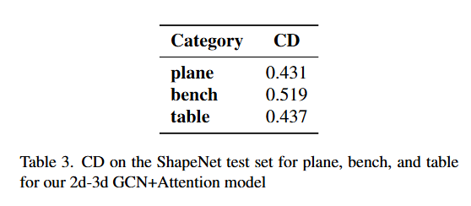
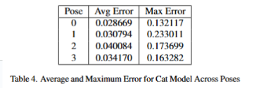
Results continued and Inference
Preliminary experiments show promising progress in building and validating the pipeline. Key observations include:
Pixel2Mesh Baseline: It serves as a foundation for mesh deformation, demonstrating effective and visually accurate results.
Attention augmented graph convo: The implementation of our proposed model.
Hyperspectral Inverse Skinning and Bone Rig: Delivers results closely resembling input meshes, validating its accuracy in capturing realistic deformations. The Bone rigs are also qualitatively good.
Error Analysis:
Hyperspectral Inverse Skinning: Even though this is not learnable module, error occurs due to subjectivity in choice of number of handles and maximum number of iterations run before convergence.
3D Reconstruction: For complex images, it is possible that the model finds it challenging to map the corresponding features to mesh outputs.

Slide 10
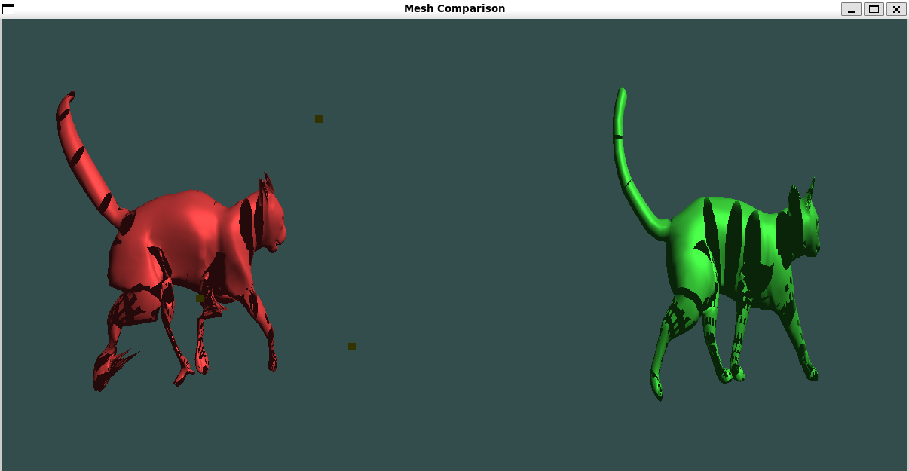
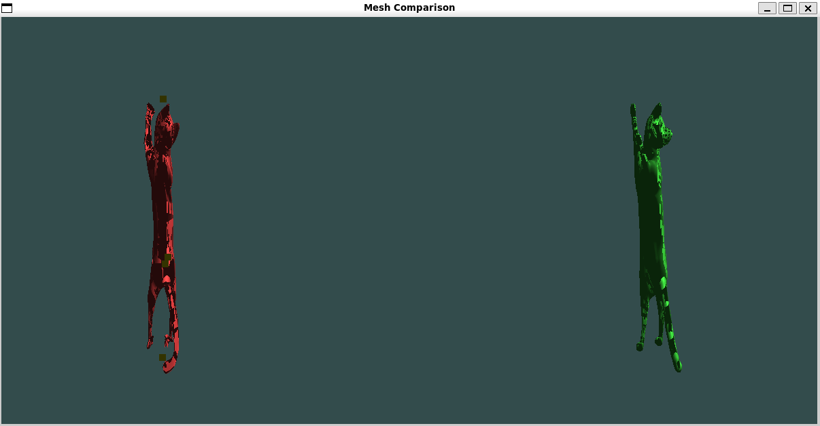
What Next?
Real-World Validation: Collect a small set of real world images, reconstruct corresponding 3D poses, and evaluate against ground-truth data to assess practical performance.
Adversarial Extensions (Future Work): Investigate the development of an end-to-end adversarial or other learned architecture to unify the reconstruction and inverse skinning steps, aiming for a single streamlined process beyond the current project scope.
Improvements in the Bone Generation model for complex movements.
An automated connection of all the tasks making it one streamline process.

